Slide 1

CHEMEX 33 GTC Concentrate
Bacterial formulation specifically designed for use in drain and grease trap maintenance

Slide 2
Bacterial formulation specifically designed for use in drain and grease trap maintenance
  Higher concentration of bacteria due to the difficulties posed by grease within maintenance applications
  Superior in degrading fats, oils and grease
  Most appropriate for grease trap and drain maintenance
  Fresh Fragrance

Slide 3
Purpose
An effective formula to treat heavy grease problems in drain lines, grease traps, grease interceptors, and sewer lines
  Grease interceptor: specialized compartment of a sewer line that traps grease so not to clog lines or overwhelm treatment plants downstream
  Grease Trap: small collection area to trap grease for easy removal and rendering
  Offers an effective odor control solution for severe and rancid odors commonly associated with grease traps

Slide 4
Previous Chemistry
  Petroleum-based surfactant
  Industrial solvents
  High emulsifying surfactants and terpenes
      Liquefies grease so it moves downstream and reduces pumping efforts
    Slow to biodegrade
    Harsh to the environment

Slide 5
New Improvements - 2016
Surfactant
  Non emulsifying surfactant
    Removes grease from the walls of the surface
    Does not liquefy grease to pass it down stream
    Soften the grease to make it easier for the bacteria to digest it
  Biodegradable surfactant
    Safer for the environment
    Safer for operations
    Readily biodegradable
    Low toxicity

Slide 6
Biological Advantages
The 7-strain blend in this product was carefully selected, in studied proportions, and by their enzymatic production
4x – 8x higher counts than industry standards
We chose:
  Our best lipase producers to degrade fats, oils and greases
  Our best protease producers to degrade all types of proteins
PERFORMANCE DATA
Proven Performance
Waste Degradation

Slide 7
The graph shows the degradation of two oils commonly found in grease traps. This specific consortium was chosen based on its ability to produce lipase. The bacteria show instant activity on these hard to degrade substrates.

Slide 8
There is a 35% improvement in the canola oil by the strains in the new Chemex 33 GTC
(new GTC in red, old in orange)

Slide 9
ppm FOG measured using InfraCal® TOG/TPH Analyzer (Model HATR-T2), by Wilks Enterprise, Inc. This represents a 55.6% Degradation of FOG in 72 hours

Slide 10
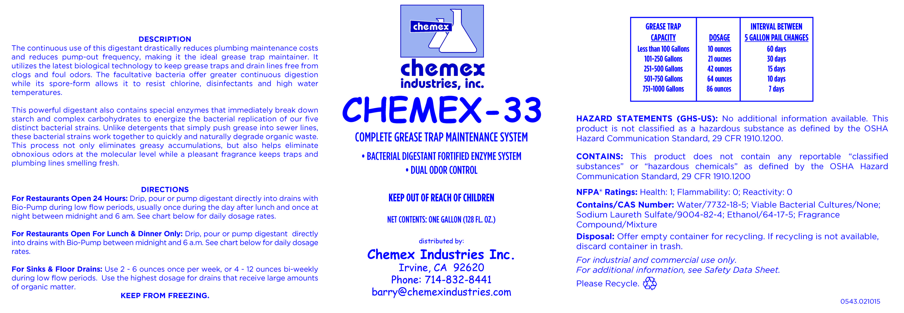

Slide 11

Thank You

